Slide 1

CANADA:
“Where People Live & How They Trade”

Slide 2
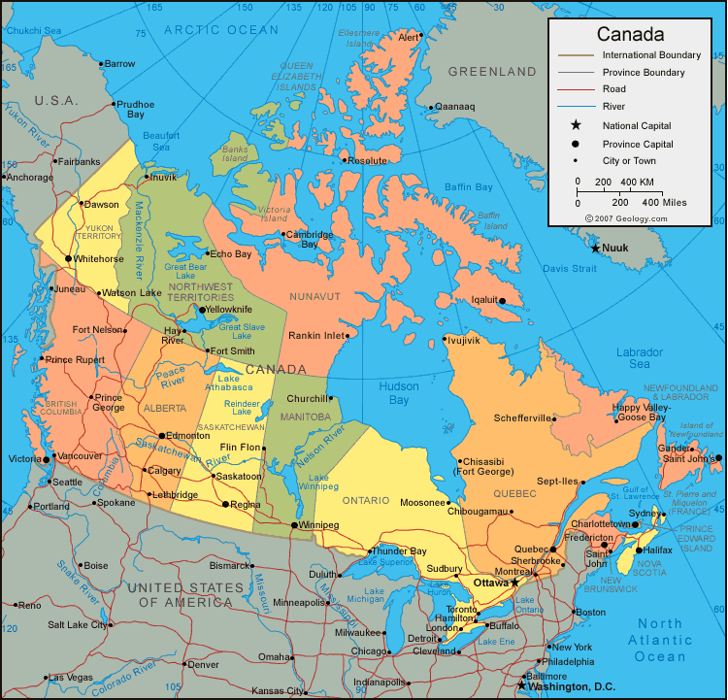

Slide 3
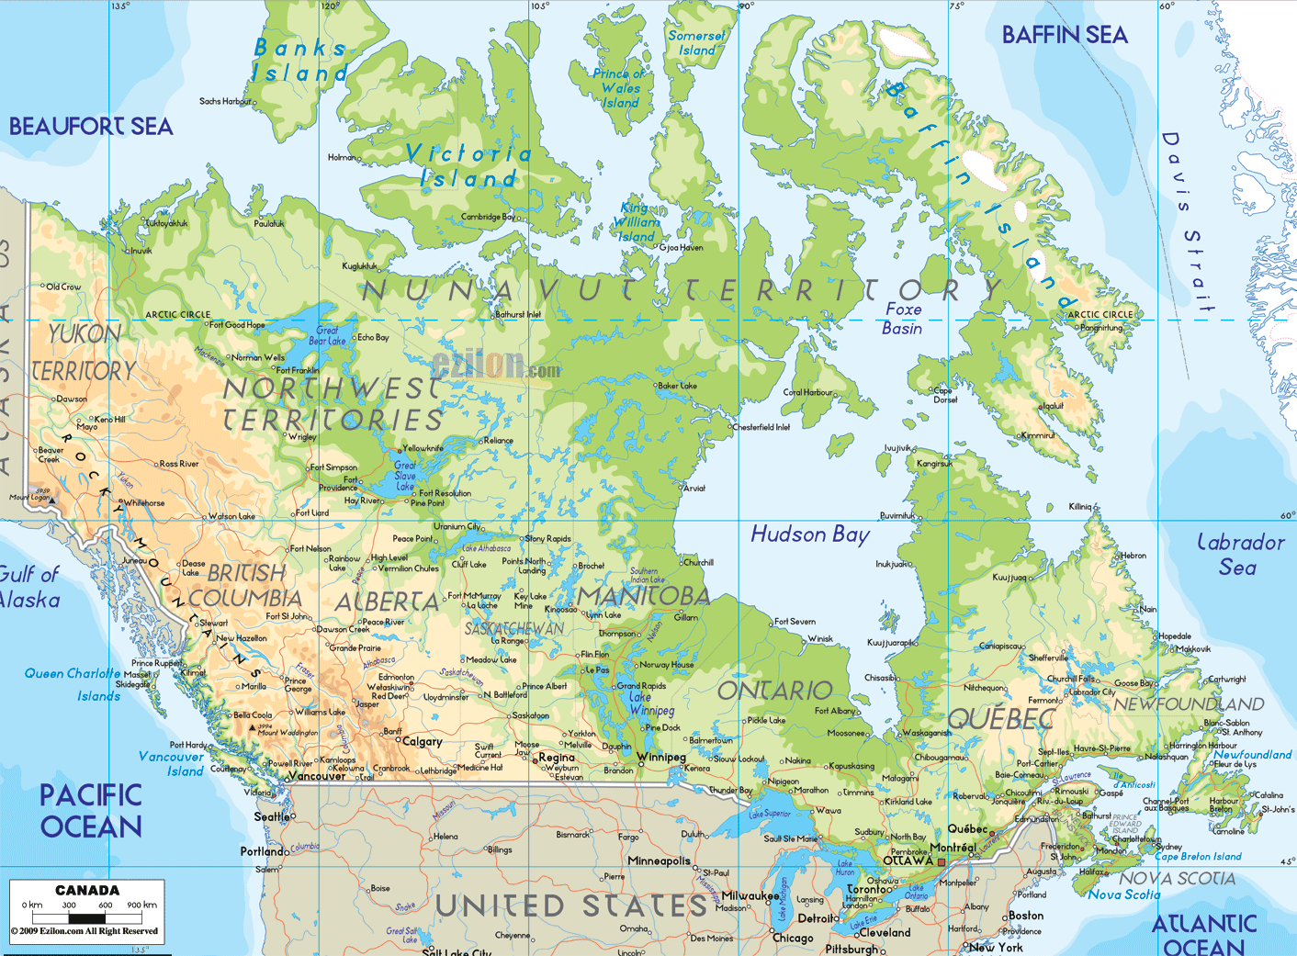

Slide 4
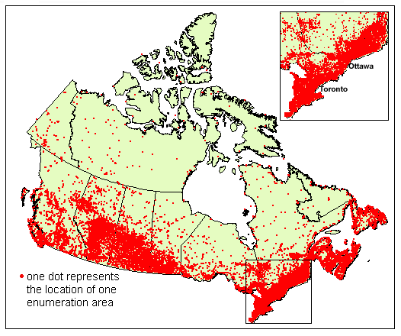

Slide 5

Location of Canada
2nd largest country in the world (Russia is larger)
Surrounded by three oceans: Atlantic, Arctic, & Pacific Ocean
Southern border is the USA
  Alaska also forms part of the western border
Population is 33 million, which is small compared to its size (US population is 9 times larger!)
  90 percent of population lives within 100 miles of the US-Canadian border…WHY?

Slide 6
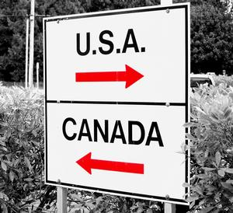
Location and Trade
Canada’s location in the world helps it to be a leader in world trade:
  It’s uniquely located on 3 oceans, so it has opportunities to trade with Europe & Asia
  Great Lakes and the St. Lawrence Seaway allow goods to be shipped to and from central Canada and the Atlantic Ocean
  A major benefit for Canada is its border with the US (#1 trading partner)
    Share over 3,000 miles of border & trade is relatively easy
    80% of Canada’s exports come to US

Slide 7
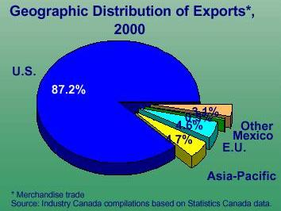

Slide 8

Canada's Climate
Southeastern part of Canada has a MUCH warmer climate than the rest of the country
  Warm to hot summers & cold winters
  Allows for a long growing season
Pacific coast has a temperate climate
  Pacific ocean cools the region in summer and warms it in winter
  Over 100 inches of precipitation per year
Northern Canada is COLD!
  Few people live here – temperatures can be below freezing even in summer!

Slide 9
Climate and Trade
Climate helps Canada trade with other countries
Southern part is good for farming:
  Long growing season and ample rainfall helps Canada produce canola, wheat, and other grains in large quantities
  These are exported and traded for goods that aren’t produced in Canada
Excellent system of highways, railroads, and air transportation has been built and adapted to the colder climate
  Even though it’s colder than the US, it’s not too harsh for trade to take place

Slide 10
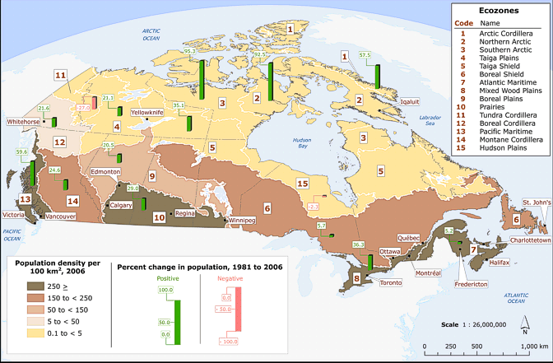

Slide 11

Canada's Natural Resources
Rich in natural resources:
  coal, oil, natural gas, iron ore, nickel, zinc, copper, gold, lead, molybdenum, potash, diamonds, & silver
Rivers and lakes have an abundance of fish, fresh water, & hydroelectric power
Good soil allows farmers to grow crops for Canadians with enough left over to trade with other countries
Timber is also a natural resource
of major importance

Slide 12

Natural Resources and Trade
Sells oil and natural gas, fish, agricultural products, & timber to other countries
Hydroelectricity is used in Canada and also sold to the US
5% of the land in Canada is arable (actually a large amount because there is so much land)
  Rich soil produces valuable crops that are consumed in Canada and traded to other countries

