Slide 1
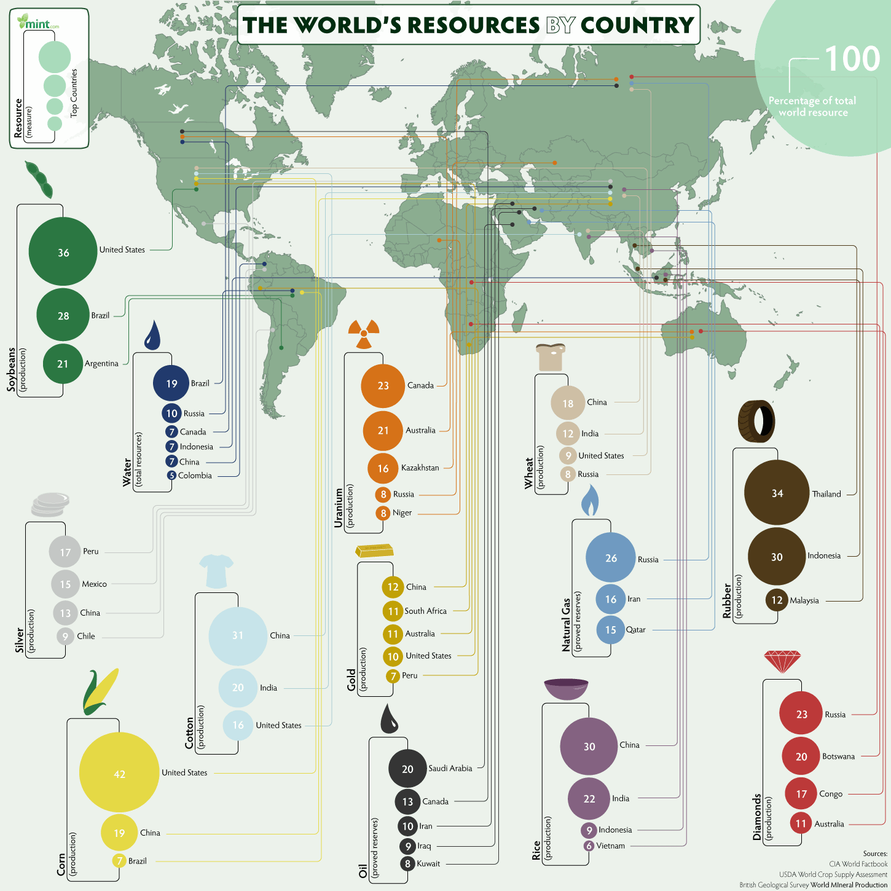
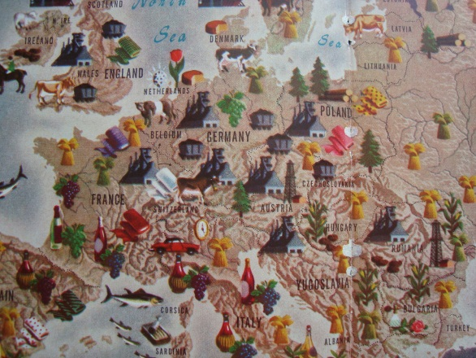
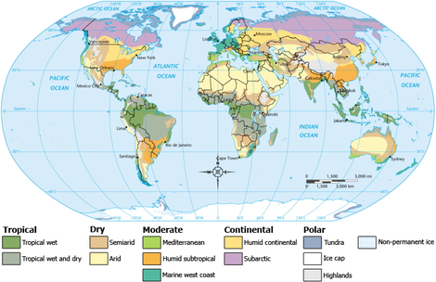
Geography Vocabulary
Location: a particular place, deals with relative and absolute location (longitude and latitude)
Climate: a region with particular weather conditions
Natural Resources: materials or substances such as minerals, forests, water and fertile land that occur in nature and can be used for economic gain

Slide 2
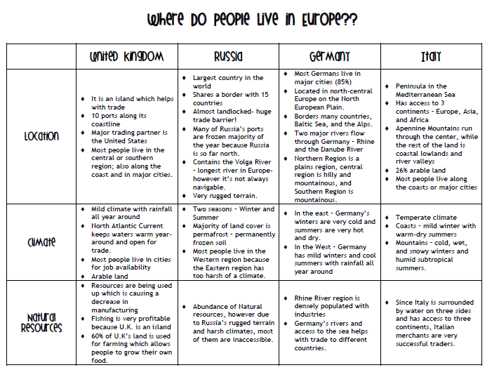

Slide 3
Venn Diagram
United Kingdom
Russia
Largest country in world
15 countries border it
Landlocked
Many ports frozen during year due to weather conditions
Longest River = Volga River
Very rugged terrain
Island
10 coastline ports
USA major trade partner
Mild climate
Arable land
North Atlantic Current warms water year round
Most people live along the coast/major cities
Located in Europe
Have Natural Resources
Most people live in the cities
Have coastal ports
Two seasons (Summer/Winter
Land covered in permafrost
Most people live in western region due to the harsh climate in the eastern region
Resources used up
Fishing profitable
60% of land used for farming
Abundance of inaccessible natural resources

Slide 4
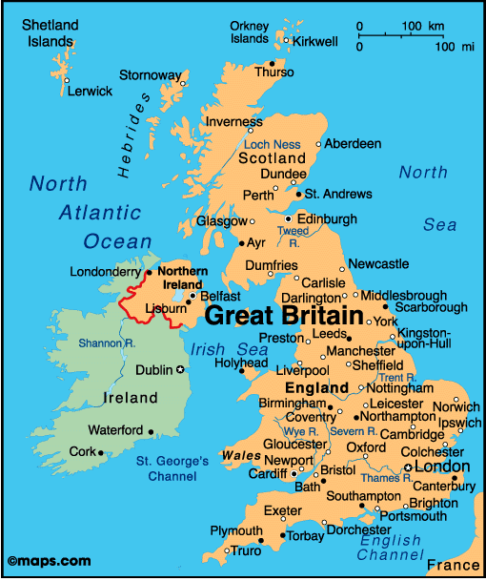
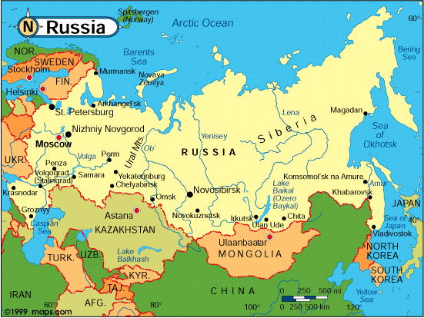
Russia and United Kingdom

Slide 5
Venn Diagram
Germany
Italy
Located in north-central Europe on North European Plain
Borders – Baltic Sea, Alps, France, Poland, Switerland
Two major Rivers – Rhine and Danube
North – plains, Central – hills/mountains, South - mountainous
Peninsula in the Mediterranean Sea
Access to 3 continents
Major of land - Apennine Mountains (center) rest of land coastal lowlands/river valleys
Population lives on coast/major cities
26% arable (farm) land
Temperature Climate
Coasts (mild Winters with warm/dry Summer)
Mountains (cold, wet, and snowy Winters and humid subtropical Summers)
Located in Europe
Trade essential to success
Largest country in world
15 countries border it
Landlocked
Many ports frozen during year due to weather conditions
Longest River = Volga River
Very rugged terrain
Merchants very successful due to location to other continents and water
Rhine river populated with industry
Rivers (Rhine/Danube) allow access to seas – helps with trade

Slide 6
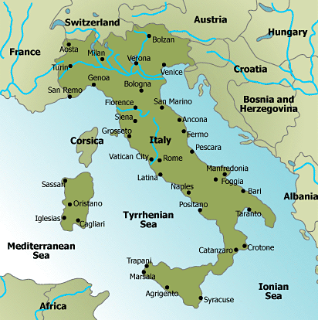
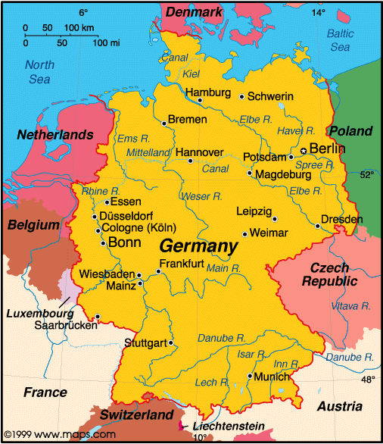
Italy and Germany

