Slide 1
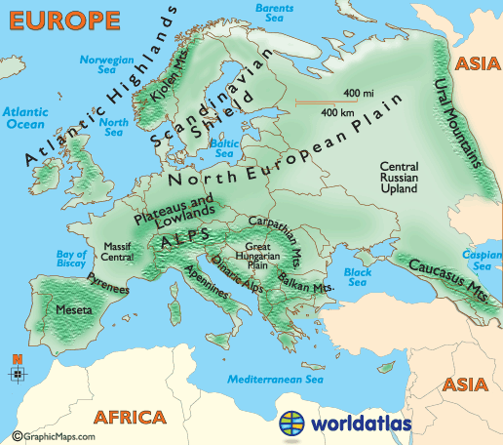
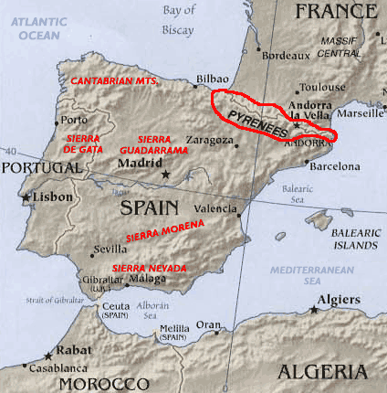
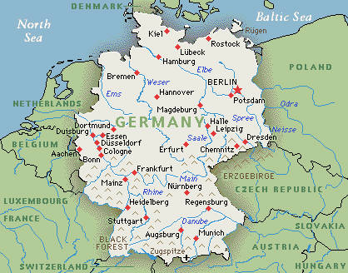
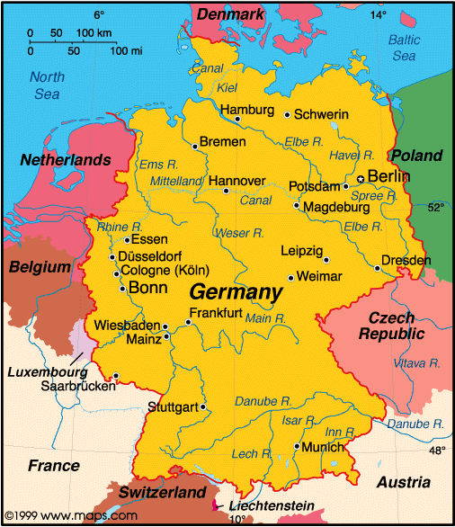
Geography Vocabulary
Physical maps show natural features of the earth; the location and names of mountains, rivers, valleys, oceans currents, and deserts
Physical Maps
A political map shows human-created features such as boundaries, cities, highways, roads, and railroads.
Political Maps

Slide 2
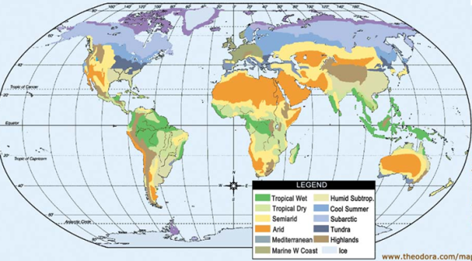
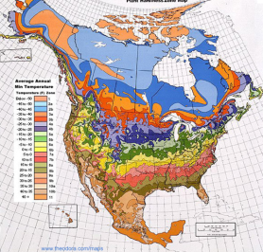
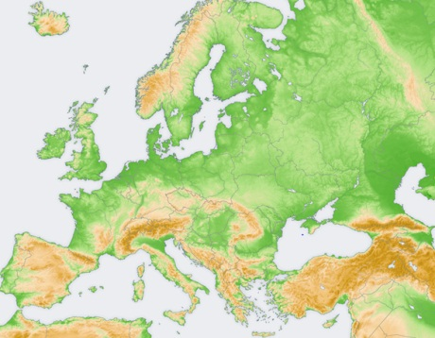
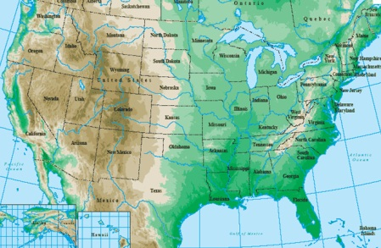
Geography Vocabulary
Climate maps show weather information including the climate and precipitation (rain, snow, droughts) in a given area. Most times the climates are shown in different colors.
Climate Maps
Topographical Maps
Topographical maps show detailed information about terrain and/or landscape within a given area. This detail normally includes natural and man-made elevation features.

Slide 3
Geography Vocabulary
? Map of Europe
? Map of Europe
? Map of Europe
? Map of Europe

