Slide 1
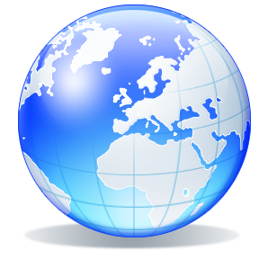
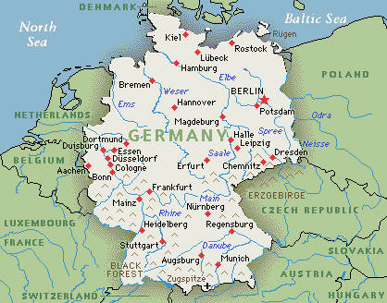
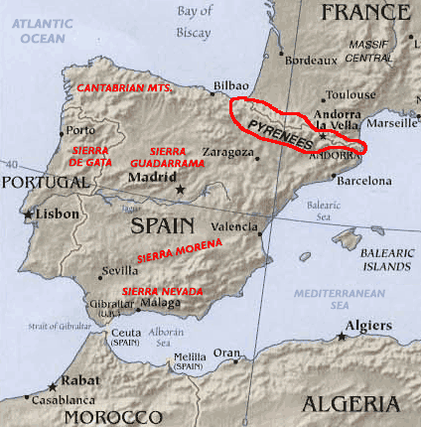
Geography Vocabulary
Border: imaginary lines created on a map to separate countries, states, cities, etc.
Boundary: a physical (natural) feature that indicates a border or limit

Slide 2
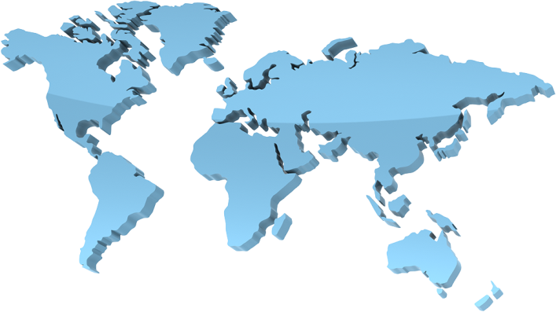
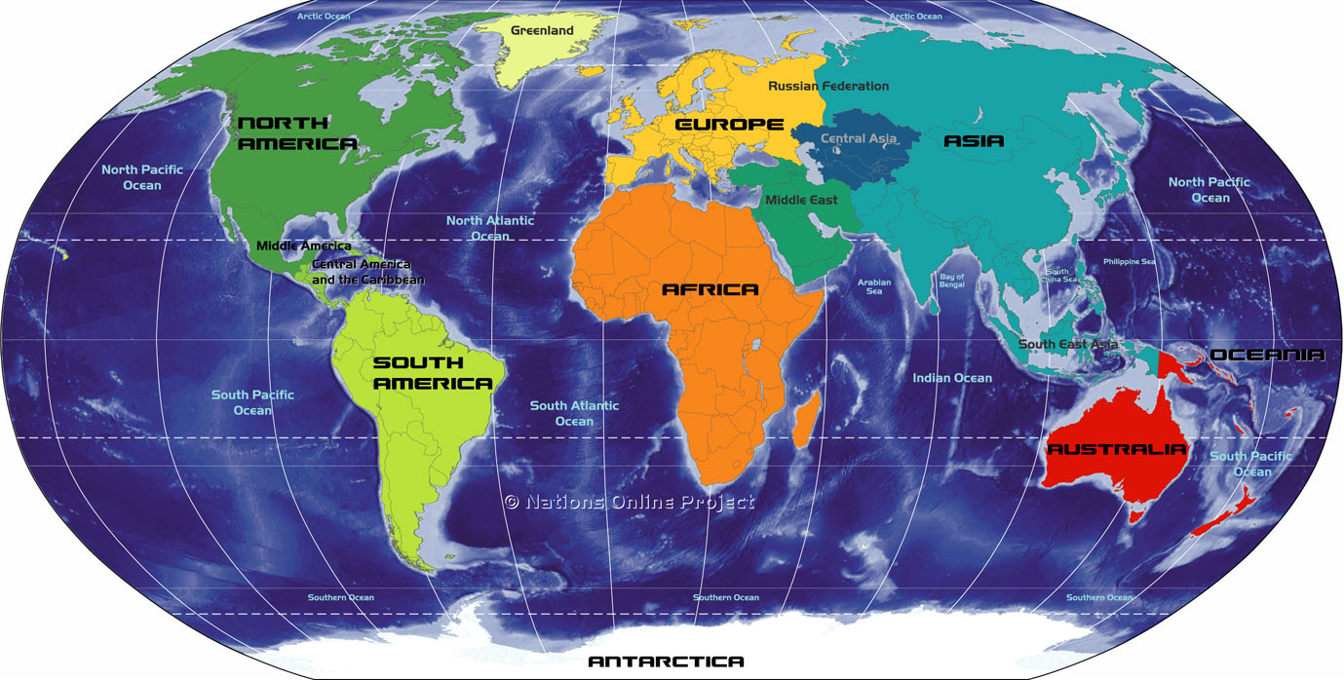
Geography Vocabulary
Continent: a massive area of land
Country: A nation with its own government, occupying a particular territory; an area of land of a nation

Slide 3
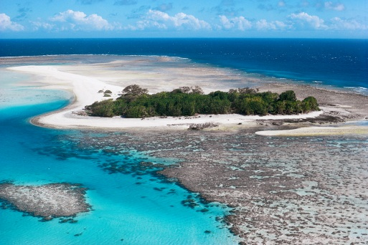
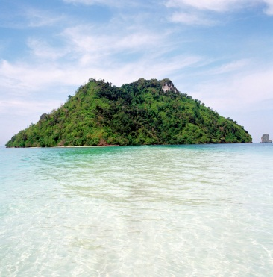
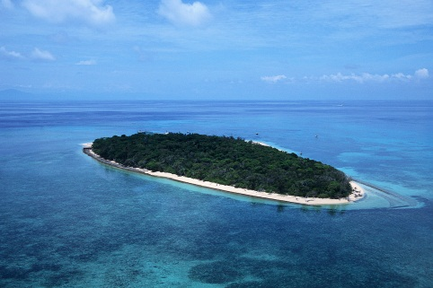
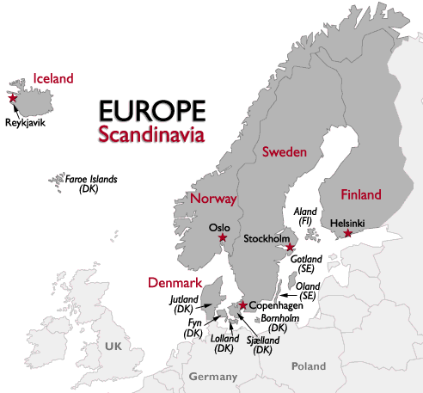
Geography Vocabulary
Island: a tract of land completely surrounded by water, and not large enough to be called a continent
Peninsula: a geographical formation consisting of an extension of land from a larger body that is surrounded by water on three sides

Slide 4
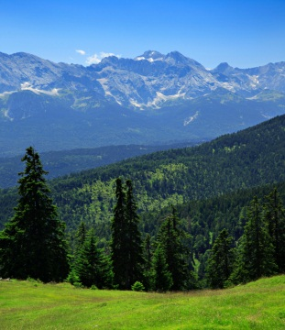
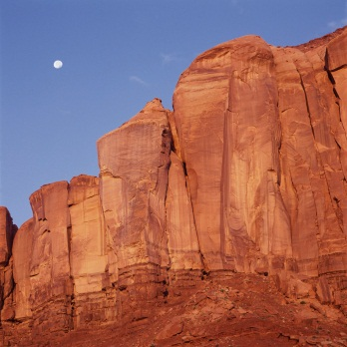
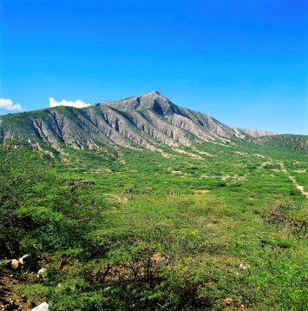
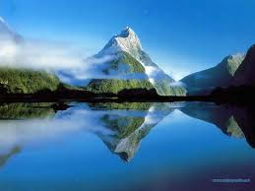
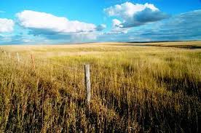
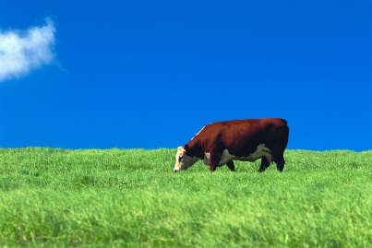
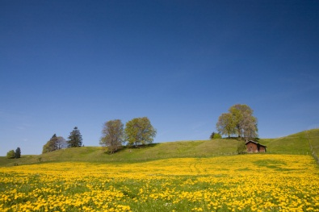
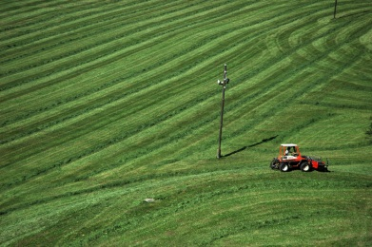
Geography Vocabulary
Mountain: a land mass that projects well above its surroundings; higher than a hill
Plain: extensive tract of level open land

Slide 5
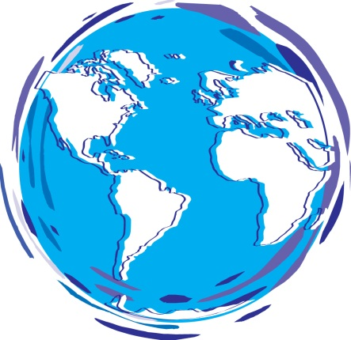
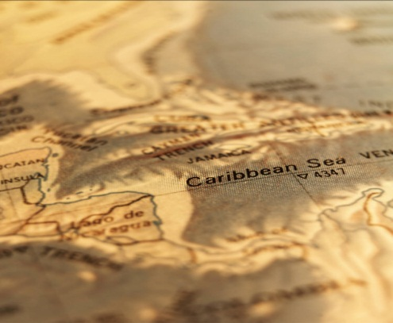
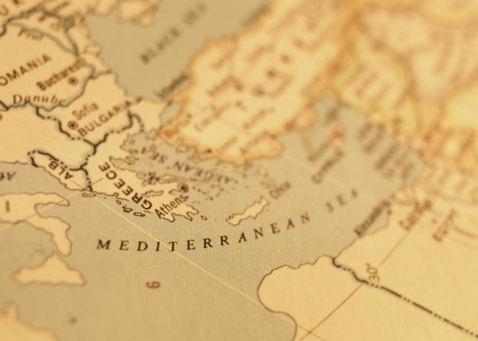
Geography Vocabulary
Ocean: the vast body of salt water that covers almost three fourths of the earth's surface
Sea: divisions of the oceans marked off by land boundaries

Slide 6
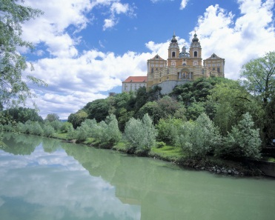
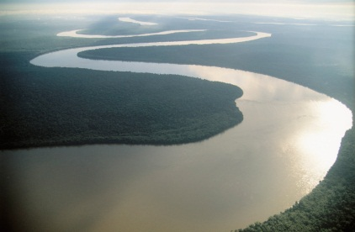
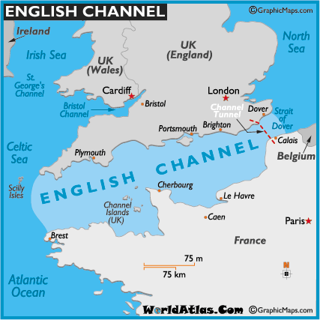
Geography Vocabulary
River: a stream of water of large size flowing into a lake, channel, sea or ocean
Channel: a wide strait, as between a continent and an island

