Slide 1
European History Significant People Exploration - Age of Imperialism

Slide 2
Significant People – Renaissance and Reformation
Johannes Gutenberg – Invented the printing press
William Shakespeare – Wrote Romeo and Juliet, Hamlet, and Macbeth.
Leonardo Da Vinci – Painted the Mona Lisa and The Last Supper.
Martin Luther – Started the reformation in Europe and also translated the Latin Bible into German.

Slide 3
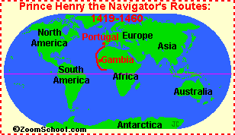
Significant People – Age of Exploration
Prince Henry the Navigator – Portuguese explorer who established/created a school to study the art of navigation, mapmaking and shipbuilding.
He sponsored voyages down the African coast.

Slide 4
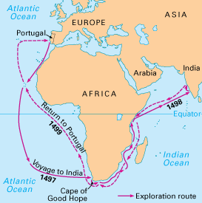
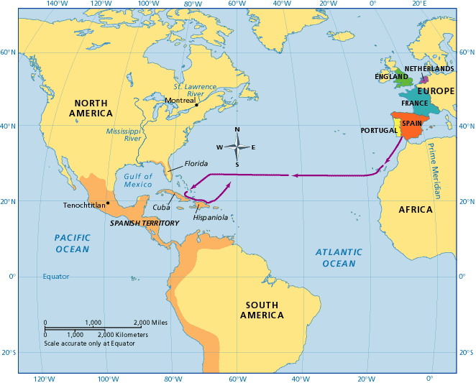
Significant People – Age of Exploration
Vasco Da Gama –
First European explorer who sailed from Portugal to India.
Christopher Columbus – Credited for discovering the New World. He created detailed maps of the Caribbean and Central America.

Slide 5
Significant People – Age of Exploration
John Cabot – Explored and claimed part of Canada for the British.
Ferdinand Magellan – First explorer to completely sail around the world (although he died). He named the Pacific Ocean. Strait of Magellan (Southern tip of South America) is named after him.
Jacques Cartier – Sailed the St. Lawrence Seaway for France.

