Slide 1
European History Exploration and Explorers Age of Imperialism

Slide 2
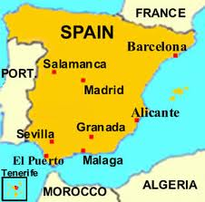
Spain

Slide 3
Explorers from Spain
Christopher Columbus
Ferdinand Magellan
Vasco de Balboa
Francisco Pizzaro
Hernan Cortez

Slide 4
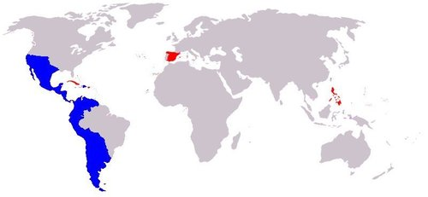
What present-day countries did Spain colonize?
All of Central and South America except Brazil and French Guinea
Philippines
Guam
Western Sahara
Equatorial Guinea

Slide 5
When did Spain control these Empires?
From the early- mid 1500s Spain started colonizing different areas of the New World. Spain colonized place all around the world. This lasted until 1914.

Slide 6
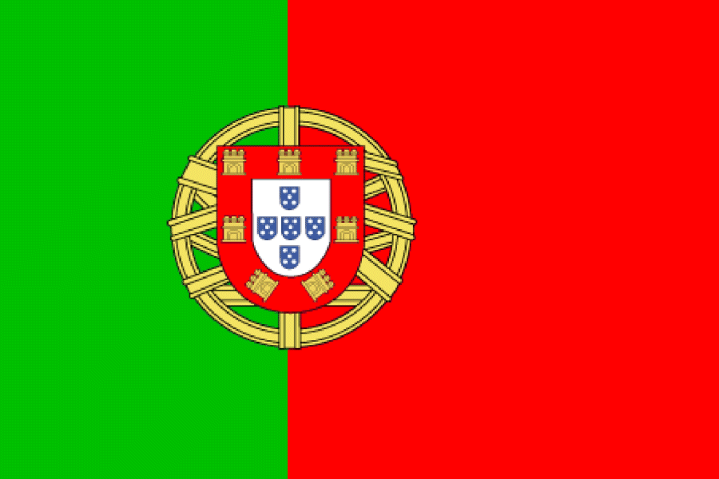
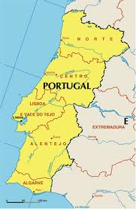
Portugal

Slide 7
Explorers from Portugal
Prince Henry the Navigator
Barolomeu Dias
Vasco De Gama

Slide 8
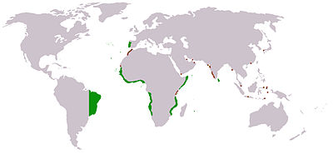
Portugal’s Colonies
Brazil
Angola
Guinea-Bissau
Mozambique
Japan

Slide 9
When did Portugal control these Empires?
From the early- mid 1500s Portugal started colonizing different areas of the New World. Until 1822, Brazil was a very profitable Portuguese colony.

Slide 10
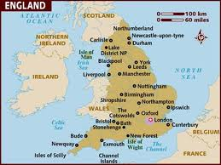
England

Slide 11
Explorers from England
John Cabot

Slide 12
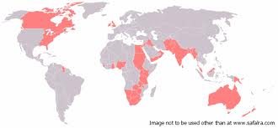
What present-day countries did England colonize?
Canada
United States
Australia
New Zealand
Malaysia
India
Pakistan
Egypt
Israel
Jordan
Nigeria
Uganda
Many others
Hong Kong was the last English colony to gain independence in 1997!

Slide 13
When did England control these Empires?
From the early- mid 1500s England started colonizing different areas of the New World. England was a strong force in the Age of Imperialism. This lasted until the late 1900s.

Slide 14
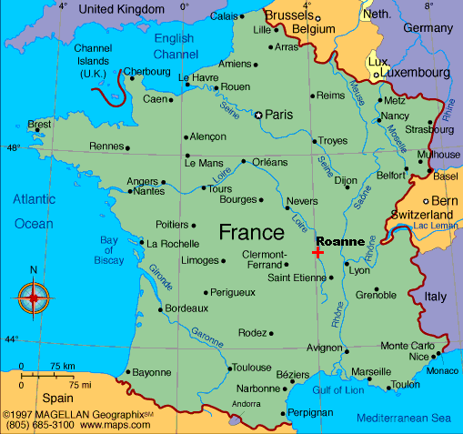
France

Slide 15
Explorers from France
Jacques Cartier

Slide 16
What present-day countries did France colonize?
French Guiana
Haiti
Western Africa
Tunisia
Cambodia
Vietnam

Slide 17
When did France control these Empires?
From the early- mid 1500s Portugal started colonizing different areas of the New World. France lost its last colony in 1962.

Slide 18
Here is a closer look at Africa’s Imperialism

